Slide 1

Welcome on behalf of our team

Slide 2

Congratulations!

Slide 3

So now…

Slide 4

Covid-19 Impact
Children and young people vulnerable due to:
  Limited exposure to disasters of this scale
  Limited life experience and coping mechanisms
  Family conflict and stress
  Excessive exposure to news and social media
  Reduction in social and physical activities

Slide 5
Covid-19 Unmasked Survey
Changes in routines
Not seeing close family members or friends
Missing important events

Slide 6

Resilience Looks Like
Trust - that the world is safe and there are caring people to help them.
Belief – that they can do things and manage themselves.
Feeling - positive about themselves and valued by others.
Optimism – that things will be alright.
Regulation - Ability to manage their feelings, thoughts and behaviours.
©Centre For Effective Living
www.effectiveliving.com.au

Slide 7
Preparing them for next steps
Play with others
Ask for help
Independence skills (toilet, feeding, dressing)
Everyday communication
Separating confidently
Reuniting joyfully
©Centre For Effective Living
www.effectiveliving.com.au

Slide 8

Preparing for school
Positive stories
Familiarisation (uniform, route, building, stationery, lunchboxes)
Reading together
Interacting with other adults
Practicing social and independence skills
Routines and rhythms of the school day
Eat and sleep well
Enjoy the process
©Centre For Effective Living
www.effectiveliving.com.au

Slide 9
Preparing ourselves for school
Practicing
Practicing separation
Managing
Managing our own feelings
Meeting
Meeting our own needs
Believing
Believing in your child, and your parenting

Slide 10
Managing Big Emotions
Help them label their emotions:
You look … is something on your mind?
If that happened to me, I would feel….
It sounds like you are feeling…..
Acknowledge and validate this as natural
Identify times of resilience and bravery in the past
Turn from “what if” to “even if” thinking
©Centre For Effective Living
www.effectiveliving.com.au
Notes:
Understanding and managing feelings
Children’s abilities for recognising, understanding and managing their emotions are inﬂuenced by the ways the adults who care for them acknowledge and respond to their feelings. When children learn to manage their emotions they are also better able to manage their behaviour. Parents, carers and school staff can provide important support and guidance for children’s emotional development.
Helpful ways of supporting children’s emotional development
Listen and validate the child’s emotional experience
Listen to what children say and acknowledge their feelings. This helps children to identify emotions and understand how they work. Being supported in this way helps children work out how to manage their emotions. You might say, “You look worried. Is something on your mind?” or “It sounds like you’re really angry. Let’s talk about it.”
View emotions as an opportunity for connecting and teaching
Children’s emotional reactions provide ‘teachable moments’ for helping them understand emotions and learn effective ways to manage them. You might say, “I can see you’re really frustrated about having to wait for what you want. Why don’t we read a story while we’re waiting?”
Encourage problem-solving to manage emotions
Help children develop their skills for managing emotions by helping them think of different ways they could respond. You might say, “What would help you feel brave?” or “How else could you look at this?”
Set limits in a supportive way
Set limits on inappropriate behaviour so that children understand that having feelings is okay, but acting inappropriately is not. You might say, “I know you’re upset that your friend couldn’t make it over, but that does not make it okay to yell at me.”

Slide 11
Development
Physically
Socially
Relationship
Shared fun and joy
Strengthen bond
Emotionally
Cognitively
In-tune
Communication
Special Time
Special time with your child through play, games, activities and everyday life provides an opportunity for development and a chance for you to fully engage with your child.

Slide 12
Signs that your child may need some help coping
Emotional
  Easily upset
  Worried or nervous
  Annoyed quickly
Persistent and they are not going away, even when the challenge is over
Getting in the way of daily life
Speak to your GP and health professional
Behaviour
  Withdrawing
  Hesitant to do what they enjoy
  Talk about the problem a lot
Physical
  Eating more or less
  Trouble sleeping
  Saying they are physically sick

Slide 13




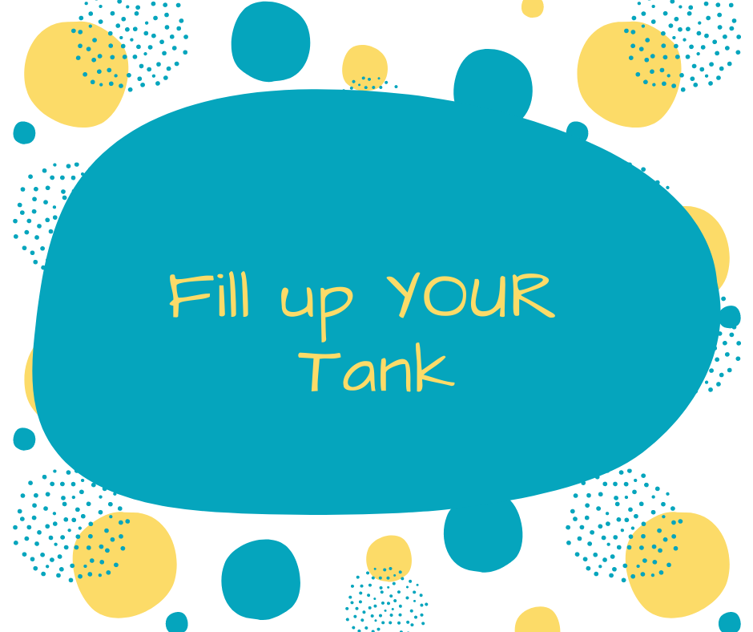
5 Truths
Thank you
Valerie Ling
Clinical Psychologist
Centre For Effective Living
www.effectiveliving.com.au
admin@effectiveliving.com.au
Ph: 1800 832 588

